Slide 1
Engineering Economy
Chapter 13: The Capital Budgeting Process

Slide 2
The objective of Chapter 13 is to give the student an understanding of the basic components of the capital budgeting process so that the important role of the engineer in this complex and strategic function will be made clear.

Slide 3
Capital financing and allocation functions are primary components of capital budgeting.
Capital financing determines funds needed from investors and vendors—in the form of additional stock, bonds, loans—and funds available from internal sources.
Capital allocation is where the competing engineering projects are selected. The total investment is constrained by decisions made in capital financing.

Slide 4
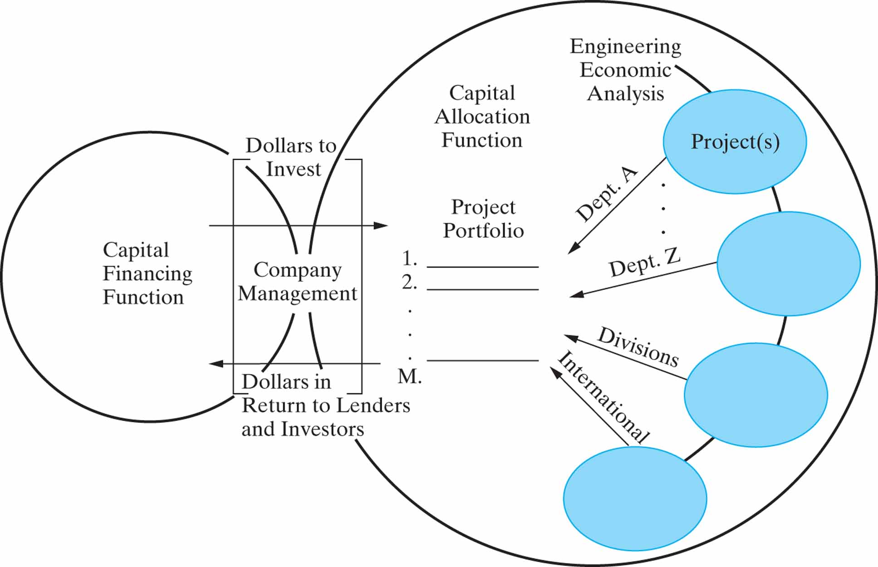

Slide 5
Management must make the decisions for the financing/allocation connection
Companies establish the allocation proposal process.
Management must select projects that ensure a reasonable return to investors, to motivate additional investment when required.
In summary, these decisions are how much and where financial resources are obtained and expended.

Slide 6
A company has a variety of sources available for capital funds. These sources expect an attractive return.
Type of Security | Average Annual Return, R_{m} | Standard Deviation of Returns
Treasury Bills | 3.8% | 4.4%
Long-term U.S. Bonds | 5.8 | 9.4
Corporate Bonds | 6.2 | 8.7
S&P 500 Stocks | 12.2 | 20.5
Small-firm Stocks | 16.9 | 33.2
Source: R.G. Ibbotson Associates, Chicago, IL., 2003.

Slide 7
Debt capital represents borrowed money.
Companies can borrow money from lenders (e.g. banks) or can issue bonds or debentures.
Creditors get interest, bondholders get dividends and face value at maturity.
The cost of bond financing depends on the bond rating, which is dependent on the financial health of the company.
Investors have a risk-free alternative of U.S. government treasure bills. This risk-free rate of return is denoted R_{F}.

Slide 8
Interest paid on corporate debt is tax deductible. This savings can be handled in two different ways.
Interest can be deducted each year before taxes are computed. This approach adds more computation, and it is generally difficult to assign debt payments to a specific project.
The most commonly used is to modify the MARR to account for the tax deductibility of the debt.
The cost of debt capital is denoted i_{b}.

Slide 9
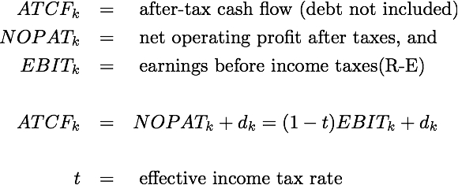
We can reflect the use of a modified MARR in the equations below.
where

Slide 10
Equity capital represents money already in the firm.
This can be capital held by stockholders through company stock.
It can also be earnings retained by the company for reinvestment purposes.
The percentage cost of equity funds, e_{a}, can be estimated in many ways, perhaps the best of which is using the capital asset pricing model (CAPM).

Slide 11
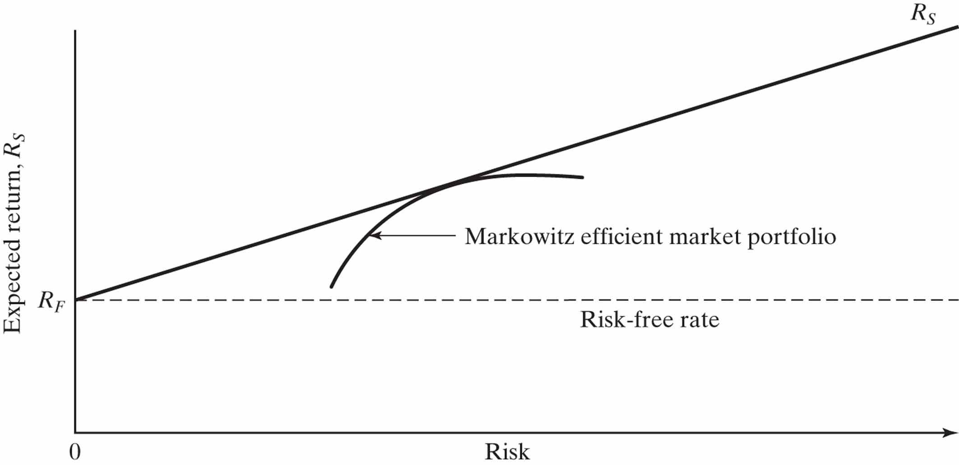
The CAPM asserts that the best combinations of risk and return lie along the security market line, SML.

Slide 12
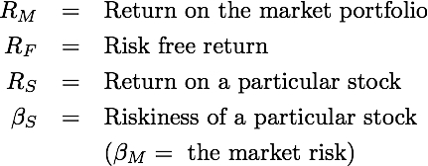
The CAPM reveals that the return, R_{S}, on any stock depends on its risk relative to the market. The risk premium of any stock is proportional to its beta.
where

Slide 13
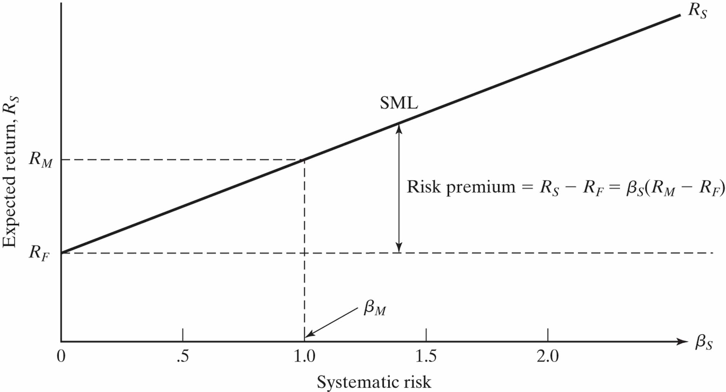
The graph below illustrates this relationship.

Slide 14
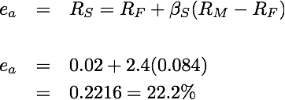
The cost of equity, e_{a}, is estimated as R_{S}.
A company has a beta value of 2.4, with no long term debt. If the market premium is 8.4%, and the risk-free rate is 2%, what is the company’s cost of equity?
so,

Slide 15
Pause and solve
Acme has a beta value of 0.7. They have no long-term debt. What is their cost of equity, based on the Capital Asset Pricing Model? Use a risk-free rate of 1% and R_{M} = 9.2%.

Slide 16
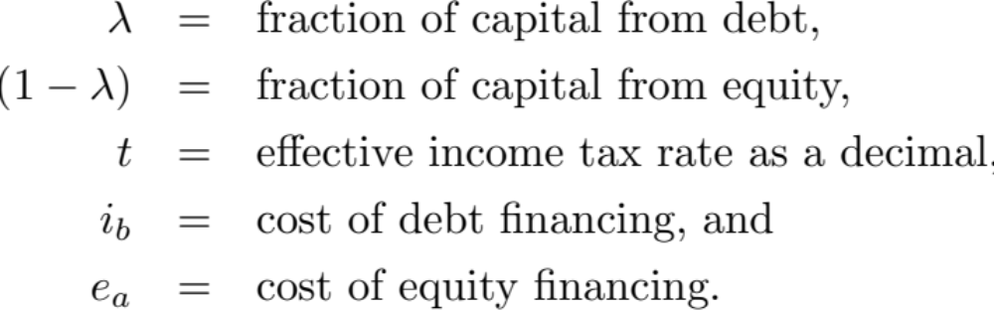
The Weighted Average Cost of Capital (WACC) represents the average cost of all funds available to the firm.
Where

Slide 17
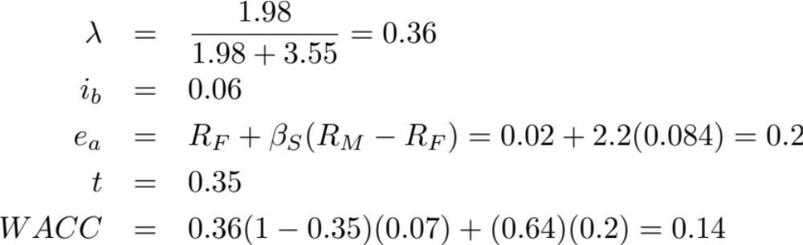
In the first fiscal quarter of 2009 Dell Computer showed total debt of $1.98mil and total equity of $3.55mil. Assume Dell’s beta is 2.2, the cost of debt is 7%, and Dell’s effective income tax rate is 0.35. What is the WACC?

Slide 18
Each company may have an “optimal” mix of debt and equity, minimizing the WACC.
One task of a company treasurer is to identify and maintain this mix.
A constant debt/equity mix is difficult to maintain over time.
The separation principle specifies that the investment decisions (project selection) and financing decisions should be separated.

Slide 19
Establishing the minimum attractive rate of return (MARR).
If risks are roughly normal, the WACC is an appropriate hurdle rate (i.e., MARR).
WACC is a floor on the MARR, which should be increased to reflect more risk.
Management may choose to set the MARR based on many factors, such as conserving capital in anticipation of large future opportunities, or encouraging new ventures. This may also be differential across divisions.

Slide 20
Opportunity costs and MARR
In this chapter we focus on independent projects.
The opportunity cost viewpoint is a direct result of capital rationing, when limited funds are available for competing proposals.
Prospective projects (of similar risk) are ranked in order of profitability. The cut-off point falls such that the capital is used on the better (more profitable) projects.
Firms may set two or more MARR levels, analyzing within particular risk categories.

Slide 21
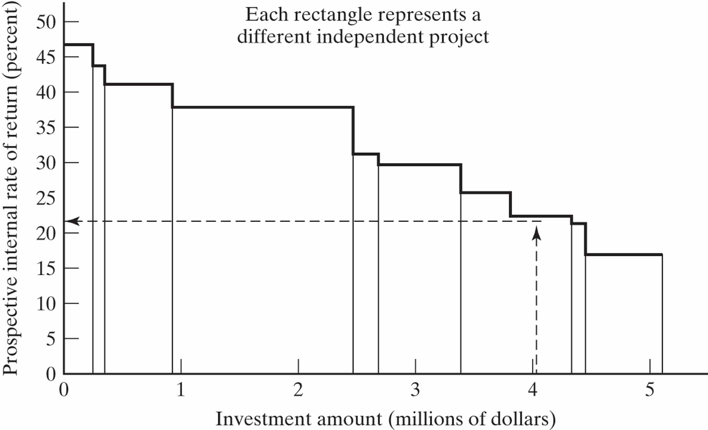
Establishing the MARR using prospective project profitability.

Slide 22
Selecting projects that are not mutually exclusive has multiple considerations.
Those projects that are most profitable should be selected, allowing for
  intangibles and nonmonetary considerations
  risk considerations
  availability of capital
In certain cases monetary return is of minor importance compared to other considerations, and these require careful judgment.

Slide 23
Investment proposals can be classified in any number of different ways, some of which are given below.
Kinds and amounts of scarce resources used
Tactical or strategic
The business activity involved
Priority—essential, necessary, desirable, or improvement
Type of benefits expected
Facility replacement, facility expansion, or product improvement.
The way benefits are affected by other proposed projects

Slide 24
There can be many possible degrees of dependency among projects.
“If the results of the first project would by the acceptance of the second project | then the second project is said to be the first project.”
be technically possible or would result in benefits only | a prerequisite of
have increased benefits | a complement of
not be affected | independent of
have decreased benefits | a substitute of
be impossible or would result in no benefits | mutually exclusive with

Slide 25
Organizing for capital allocation
Organizations generally have a formal project selection process that progresses through the organizational levels.
Clearly “good” proposals, or proposals clearly executing corporate policies, can be approved at the division level, within certain funding limits.
Proposals requiring a commitment of a large amount of funds are sent to higher levels in the organization (see the table on the next slide).

Slide 26
An example of a required organizational approval structure.
If the total investment is . . .
More than | But less than | Then approval is required through
$50 | $5,000 | Plant manager
$5,000 | $50,000 | Division vice president
$50,000 | $125,000 | President
$125,000 | -- | Board of directors

Slide 27
The process of communicating and “selling” project proposals is important.
Good communication is required regardless of the strength of the project proposal.
Consider the needs of the decision maker.
Provide investment requirements, measures of merit, and other benefits, and
  bases and assumptions used for estimates
  level of confidence in the estimates
  how would the outcome be affected by variation?
A corporate-wide proposal structure is helpful.

Slide 28
For improved capital budgeting, conduct postmortem reviews (postaudits).
It helps determine if planned objectives of the project were obtained.
It determines if corrective action is needed.
It improves estimating and future planning.
It provides an unbiased assessment of project results compared to the proposed outcomes.
Postaudits are inherently incomplete, so care should be used decisions based on these results.

Slide 29
Budgeting for capital investments is a difficult managerial challenge.
Just because a project is “attractive” doesn’t mean it should be undertaken.
Capital budgets, while perhaps with a one- or two-year horizon, should be supplemented with a long-range capital plan.
Technological and market forces change rapidly.
Decisions must be made regarding investing now or “saving” some funds to invest in the future (e.g., next year), postponing returns.

Slide 30
Lease vs. buy vs. status quo decisions
Leases allow the firm to use available capital for other uses.
Leases are legal obligations very similar to debt, reducing the ability to attract further debt capital and increasing leverage.
One should not compare only lease and buy, but also the status quo (do nothing), separating to the extent possible the equipment and financing decisions.
Always consider tax implications.

Slide 31
One way to allocate capital among independent projects is to create MEAs from the set of projects and use familiar equivalent worth methods.
Project risks should be about equal
Enumerate all feasible combinations (those that meet any budget constraints).
The acceptance of the best MEA will specify those projects in which to invest.

Slide 32
With a budget of $150,000, which of the following independent projects should Mitselfik, Inc. invest in?
Independent project | Initial capital outlay | PW
A | $70,000 | $18,000
B | $45,000 | $12,000
C | $40,000 | $11,000
D | $50,000 | $14,000

Slide 33
The set of feasible projects.
Combination | Capital required | Total PW
A | $70,000 | $18,000
B | $45,000 | $12,000
C | $40,000 | $11,000
D | $50,000 | $14,000
AB | $115,000 | $30,000
AC | $110,000 | $29,000
AD | $120,000 | $32,000
BC | $85,000 | $23,000
BD | $95,000 | $26,000
CD | $90,000 | $25,000
BCD | $135,000 | $37,000*

Slide 34
Selecting independent projects B, C, and D results in the greatest PW.
Project combinations ABC, ABD, ACD, and ABCD are not feasible because of the capital constraint.
Management must decide how best to allocate (or not allocate) the remaining $15,000.

Slide 35
Other important managerial considerations and complications.
Projects have different lives, and different cash flow commitments.
Projects have differing levels of risk.
The long-term capital plan must be considered.
The overall risk of the firm must be considered.
The corporate strategic plan may favor one part of the company over another for investment.
Much, much more. . .

Slide 36
Capital allocation problems can be modeled as linear programs.
“Brute force” evaluation of all independent alternatives, especially when the number of alternatives is very large, is cumbersome at best.
Linear programming can be used to determine an optimal portfolio of projects.
Linear programming is a mathematical procedure for maximizing (or minimizing) a linear function subject to one or more linear constraints. We will present the formulation of problems, but not the solution, which is beyond our scope.

Slide 37
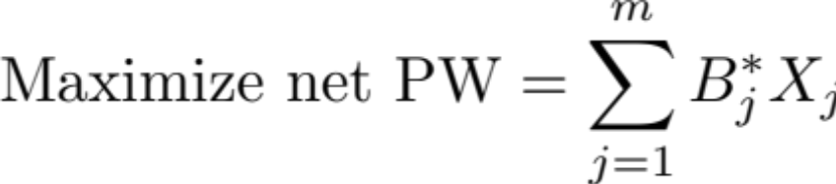
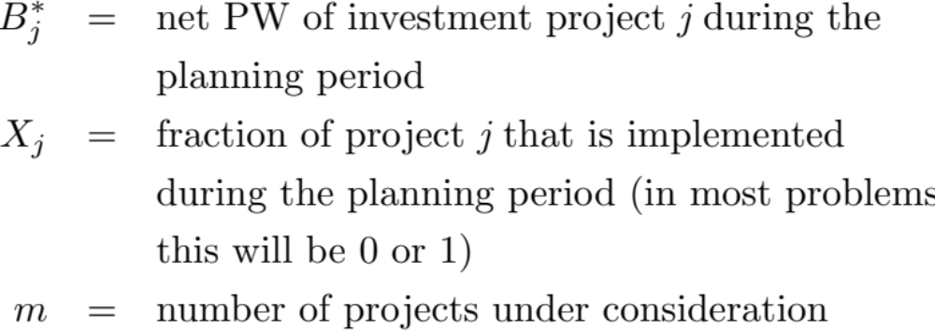
The objective function of the capital allocation problem.
where

Slide 38
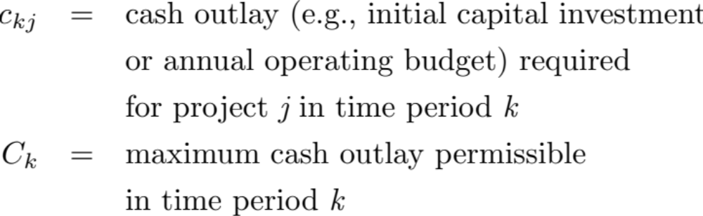
Typical constraints are limitations on cash outlays in each period, and interrelationships among projects.
Let

Slide 39
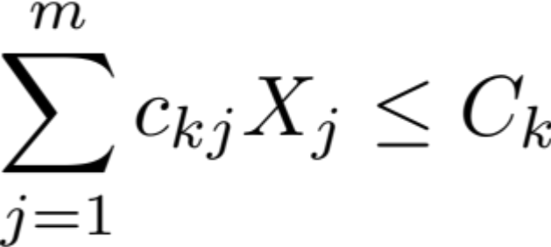

Limitations on cash outlays for period k.
If projects p, q, and r are mutually exclusive, then

Slide 40
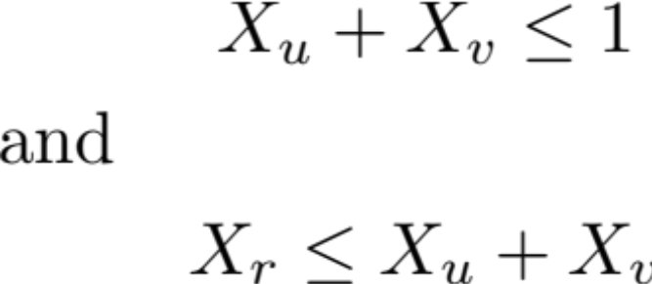
If project r can be undertaken only if project s has already been selected, then
If projects u and v are mutually exclusive and project r is dependent (contingent) on the acceptance of u or v, then

Slide 41
Consider six projects under consideration with the information below. Formulate the linear programming selection model.
Project | Initial investment cash flow ($000s) | PW ($000s) at MARR
A | -75 | 15
B1 | -50 | 11
B2 | -30 | 9
C1 | -50 | 13
C2 | -60 | 14
C3 | -15 | 5

Slide 42
Consider that B1 and B2 are mutually exclusive, and C1, C2, and C3 are mutually exclusive. C2 and C3 are each contingent on A. The budget for new projects this year is $130,000.
Objective function: Maximize Net PW

Slide 43


Constraint on initial investment.
B1 and B2 are mutually exclusive.
C1, C2, and C3 are mutually exclusive.
C2 and C3 are contingent on A.
No fractional projects are allowed.

